Slide 1
Energy Drink Marketing Analysis
- Pritam Shetty

Slide 2
Content
Objective
Observation
Recommendations

Slide 3
Objective
CodeX is a German beverage company that is aiming to make its mark in the Indian market. Their Marketing team is responsible for increasing brand awareness, market share, and product development. They conducted a survey in those 10 cities and received results from 10k respondents.
Using these survey results, develop meaningful insights which the team can use to drive actions.

Slide 4
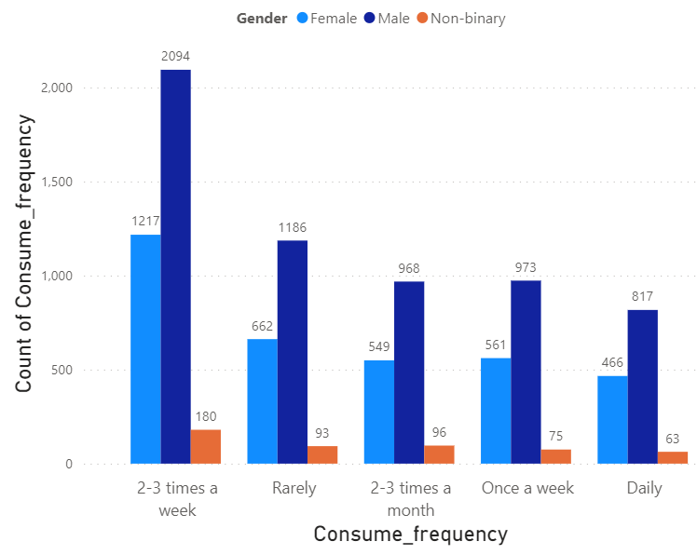
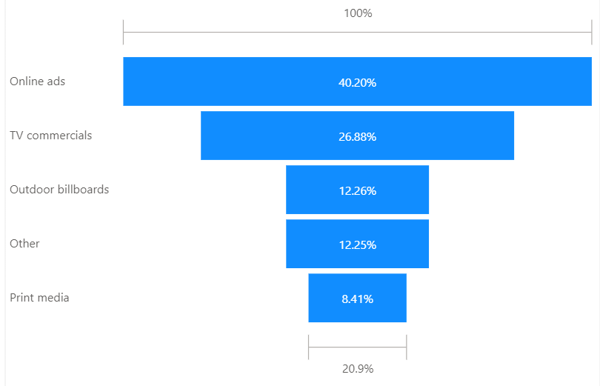
Demographic Insights
Energy drinks are common among males
Online ads are an effective marketing channel for reaching the audience
The consumers in the age group 19-30 top the list of energy drink consumers

Slide 5
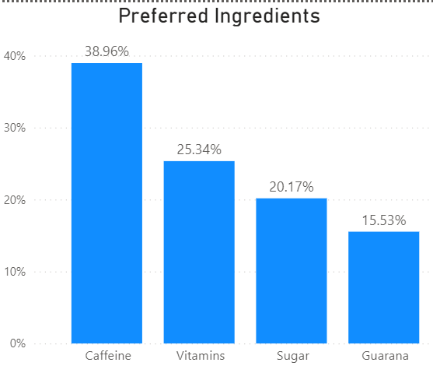
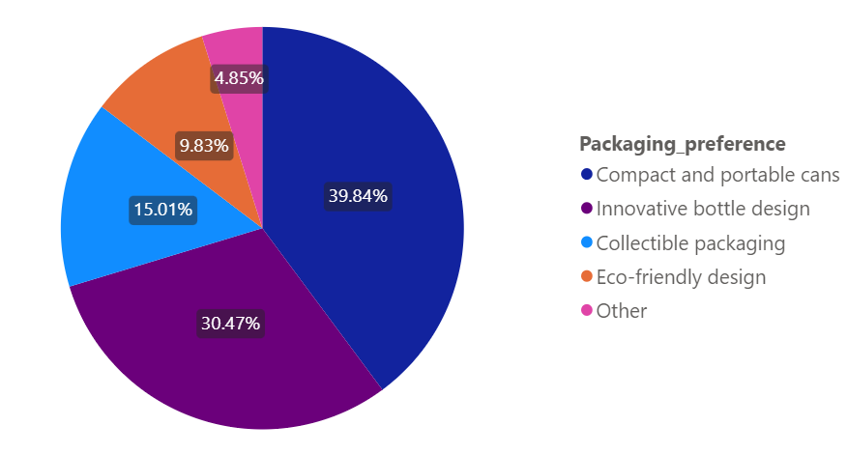
Consumer Preference
Caffeine is a highly preferred ingredient in energy drinks, as most people who consume them are involved in activities like sports and exercise. Caffeine helps them improve their performance
Consumers also prefer to have the energy drink in Compact and Portable Cans

Slide 6
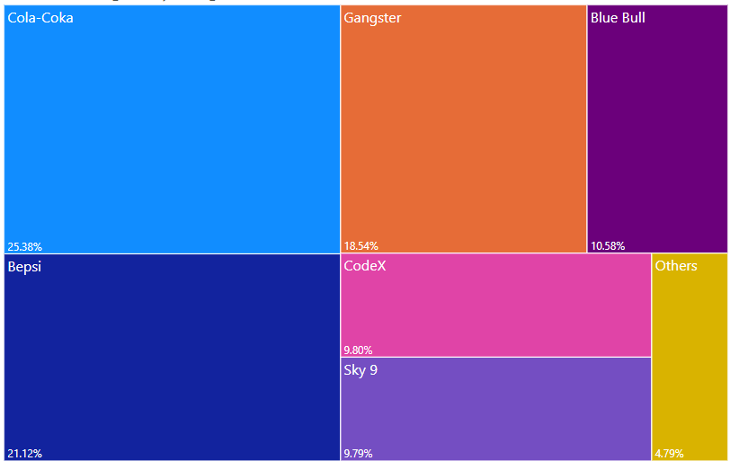
Competition Analysis
Cola-Coka has the highest market share in the energy drink segment
It has been observed that non-availability of CodeX drinks in local market as one of the reason people are not able to try it

Slide 7
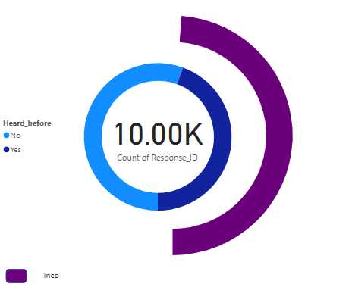
Brand Penetration
Out of 10K people who responded to survey, only 44.5% have heard about the energy drink from CodeX
Out of 4.4K, only 48% people have tried the energy drink
Hence, it is important that more focus should be given to marketing so that more people are aware of the CodeX energy drink

Slide 8
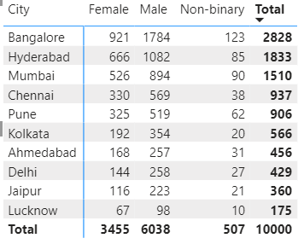
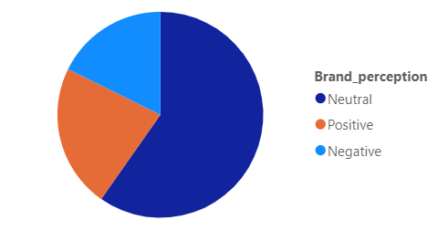
Cont.
The perception about the brand CodeX is neutral among the people who were surveyed. Hence, marketing dept needs to work so that a positive perception is developed among the consumers
The city topping the list for business are Bangalore followed by Hyderabad and Mumbai

Slide 9
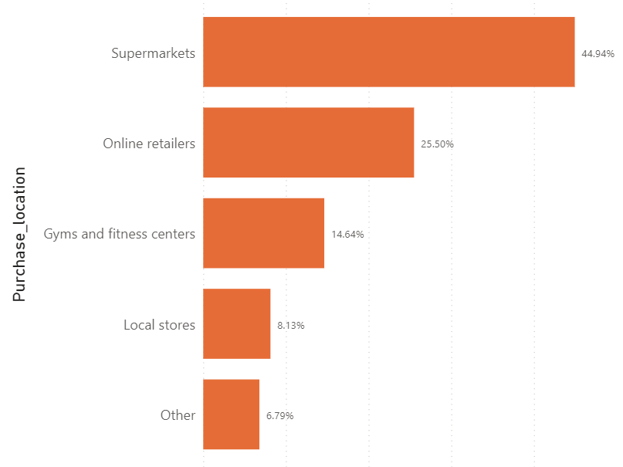
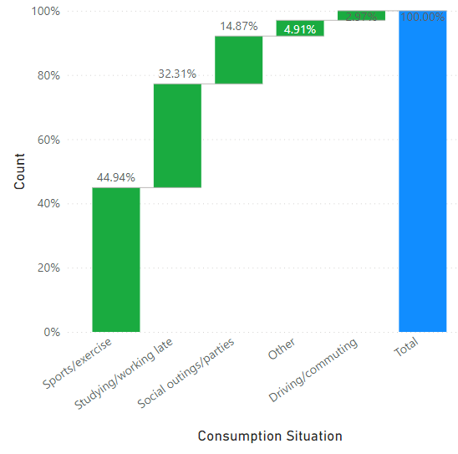
Purchase Behavior
The highest purchase of energy drinks takes in Supermarkets
The major consumers are those who are involved in Sports/Exercise

Slide 10
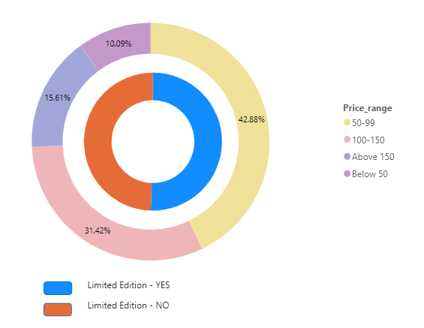
Cont.
An interesting point is that people have a neutral perspective about limited edition packaging
The company should focus on compact and portable cans
Energy drinks in the price range of 50-99 are preferred among consumers
Price below 50 is not positively taken by the customer hence can be concluded that quality of drink does matters

Slide 11
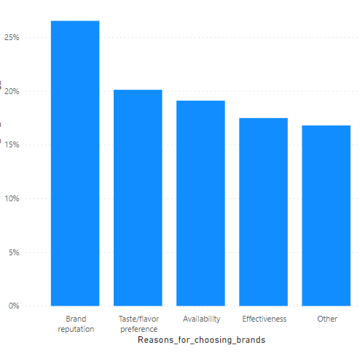
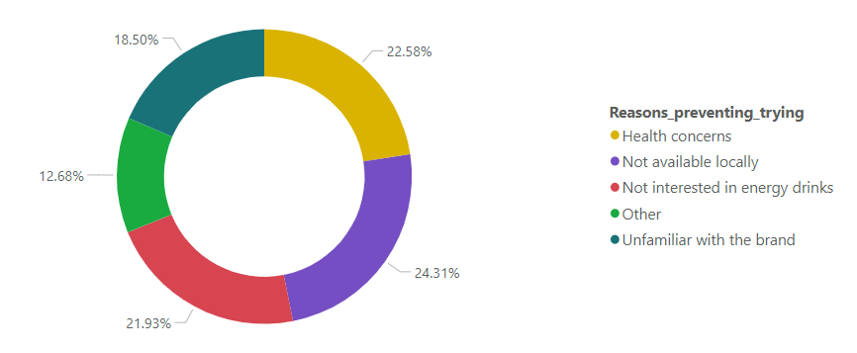
Product Development
Brand Reputation plays a vital role while selecting an energy drink
The product not being available in the local market is the major reason why consumers are not able to try the product

Slide 12
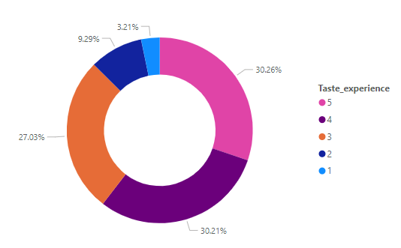
Cont.
Good feedback has been received for the product when it comes to taste. Almost 60% of consumers have voted positively for the taste

Slide 13
Recommendation
The company should focus on the supply chain as most customers are not able to try the product due to its unavailability in the local market
The preferred price rang is 55-99, hence using compact and portable cans and while maintaining the current taste and quality product must be delivered
The marketing of the product must be improved, as more than 50% people how where surveyed were not aware of CodeX energy drink
Brand Reputation plays an important role while selecting the product hence focus on correct branding of product
Cities like Bangalore, Hyderabad and Mumbai have a larger customer base for CodeX energy drink
Male, Female and Non-Binary people are consumers of energy drink, hence no special efforts required based on gender for attracting more customers

Slide 14
Thank You

